Slide 1
IWPA 2014 - 2015 Championships

Slide 2
IWPA Regional Hall of Fame
2014 – 2015 Season

Slide 3
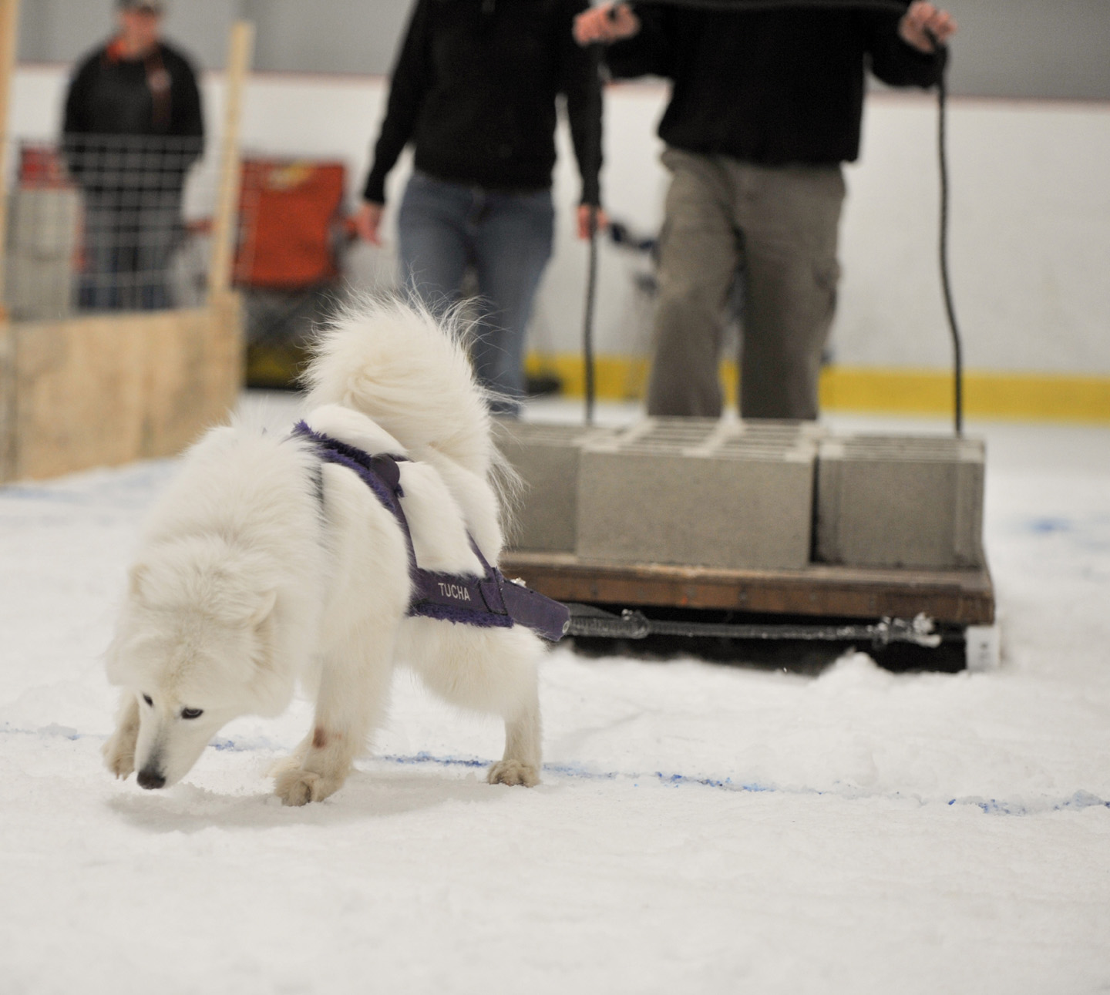
REGION 5 CH Kolfinna Tucha Rhythm of My Heart CD, RE, CGC, WSXM, SV and registered with Therapy Dog International
Owner/Handler:
Beverly Detwiler

Slide 4
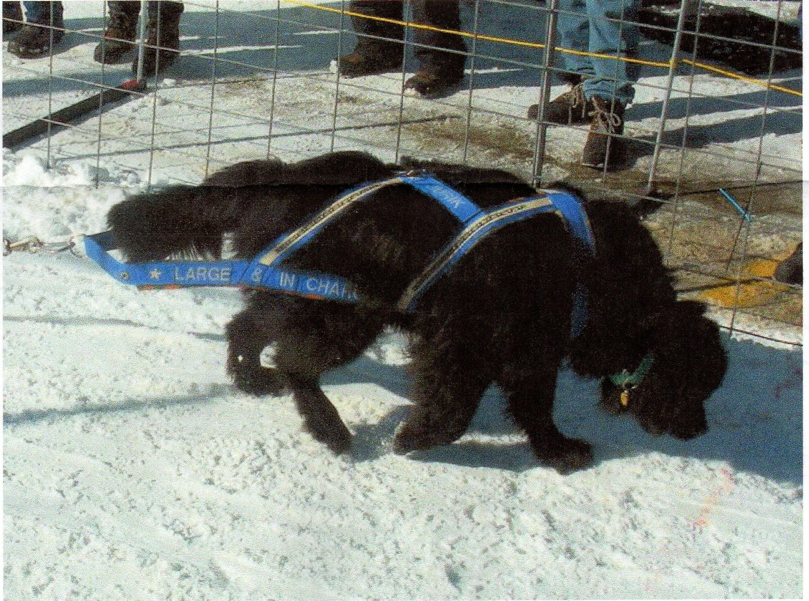
REGION 4 Carissa’s Large and in Charge CGC, DD3, WRD, RE, BN and IWPA WD
Owner/Handler
Constance Meech

Slide 5
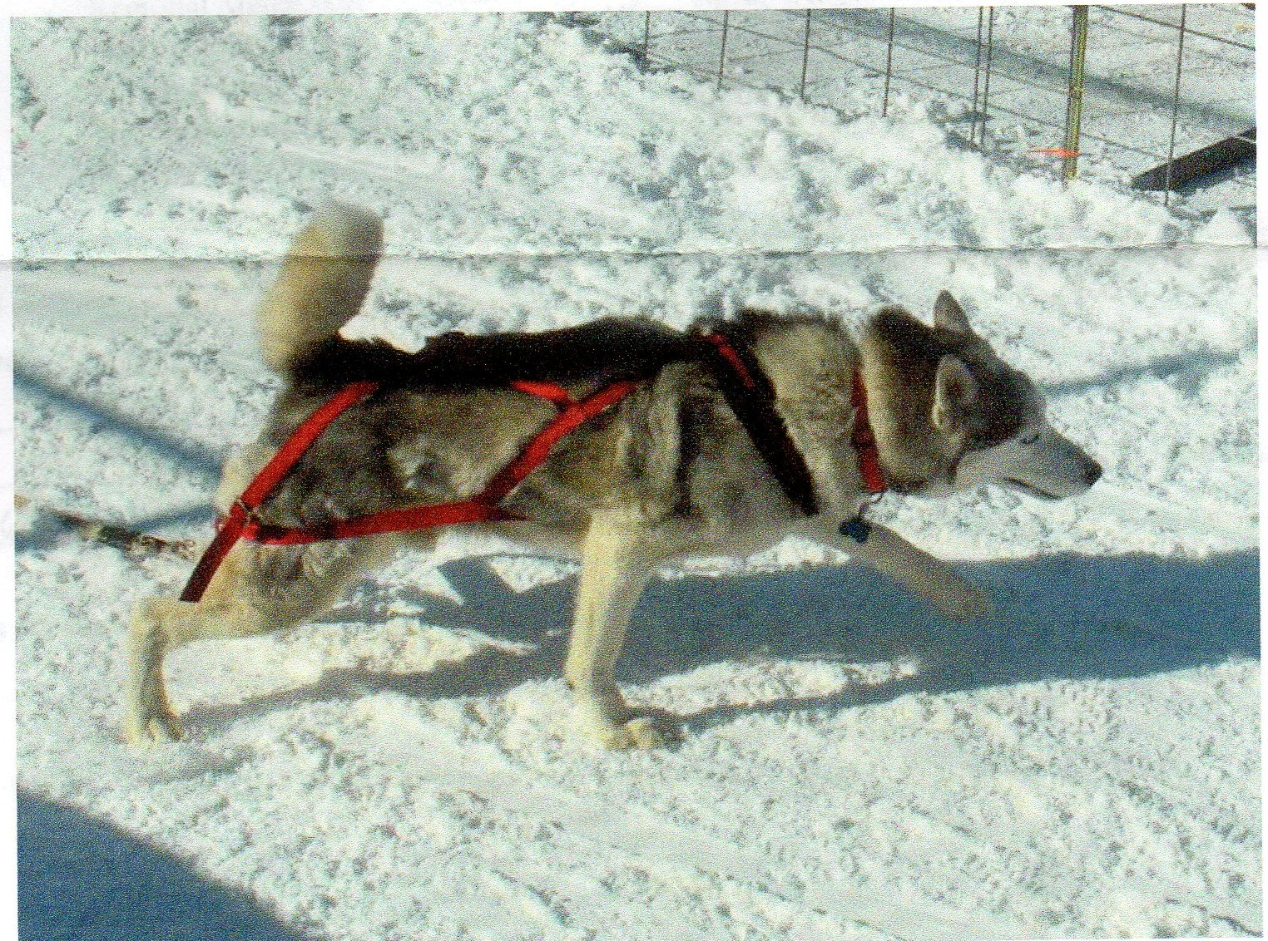
REGION 4 Aruff’s Cinnar Loki
Owner/Handler
Constance Meech

Slide 6
IWPA International Hall of Fame Inductee’s
2013 – 2014 Season

Slide 7
June 14, 2014 International Hall of Fame inductee’s
2013 – 2014 Season

Slide 8
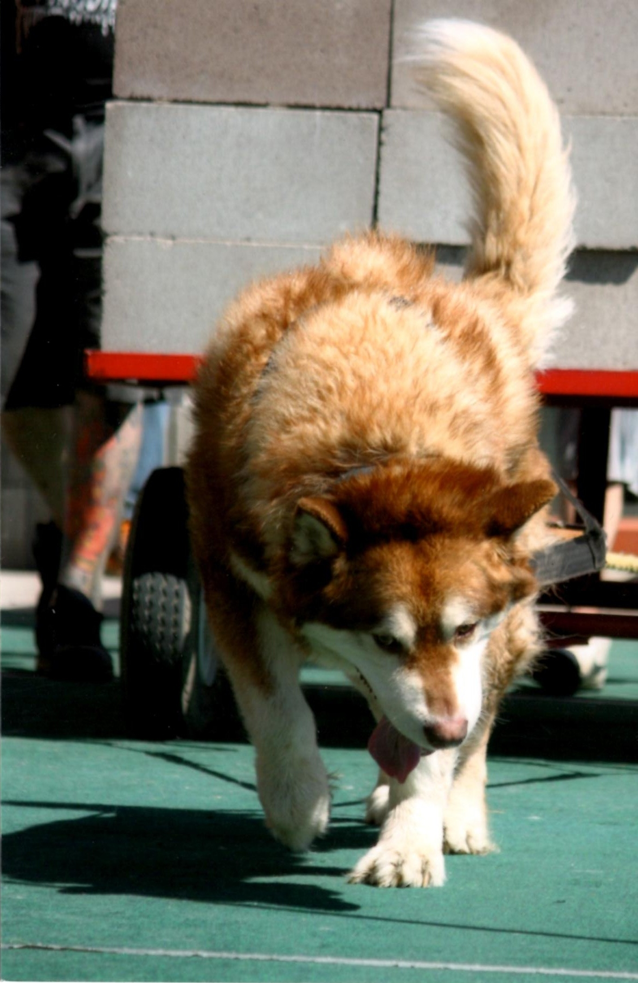
REGION 10 Cascade’s Shaman’s Dream
Owner/Handler
Jim Galli

Slide 9
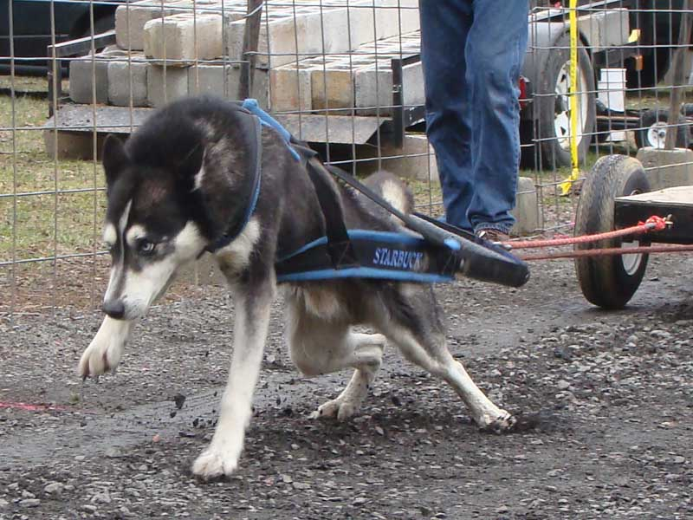
REGION 5 Starbuck
Owner/Handler
Steve Jackson

Slide 10
Congratulations to all International and Regional Hall of Fame recipients!!!

